Slide 1
Intro to Docker
By: Kirk Kratohvil

Slide 2
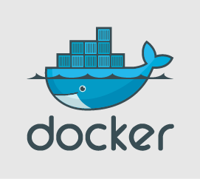
What is Docker?
Docker is an open source platform designed to build, distribute and run applications inside a container.
A container is a virtual box that packages applications with dependent services and components.
A container is like any other operating system in that it hosts system libraries, runtime environments, code needed to run applications, etc.
Docker’s containers are built on top of a Linux container, so you always need to have a virtual box running a Linux operating system in order to run your Docker container.
No matter what platform you run your contained application on, it is guaranteed to work.
Multiple containers can be created at a time using Docker.

Slide 3
What does this mean in simple terms?
This means that Docker can contain different versions of software and various applications in individual containers.
For example, if you had a few applications that were built using different versions of Ruby on Rails, you could put those different versions of Ruby on Rails in a container with its corresponding application resulting in successful launches for all of the applications.

Slide 4
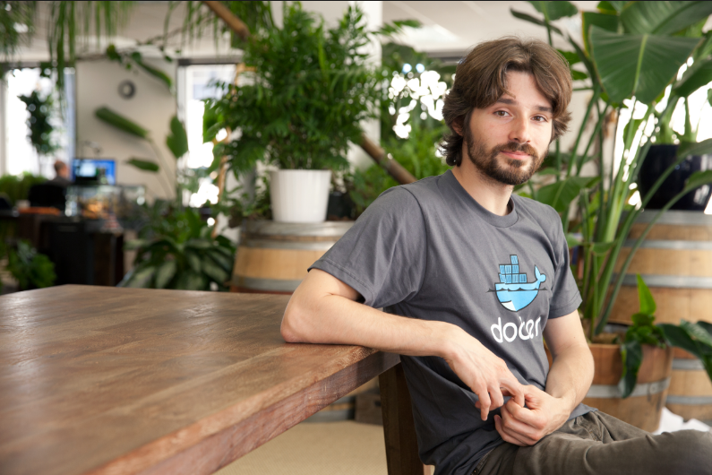
History of Docker
Solomon Hykes is the inventor of Docker.
Docker started out as an internal project at a cloud platforming business called DotCloud which is located over in France.
Docker was released as an open source product on March 13, 2013.

Slide 5

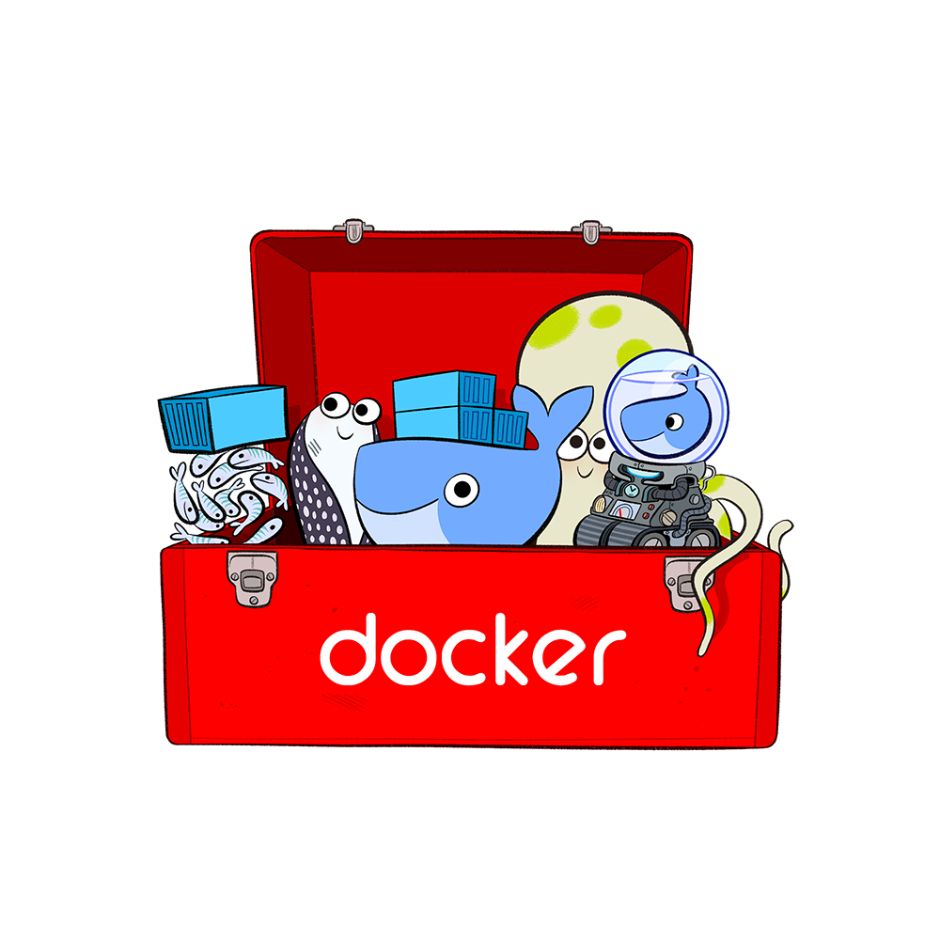


What do you need to run Docker?
Docker Terminal
Docker Toolkit
A 64-bit operating system (At least have a Windows 7 or a more up-to-date operating system)
Virtual Box

Slide 6
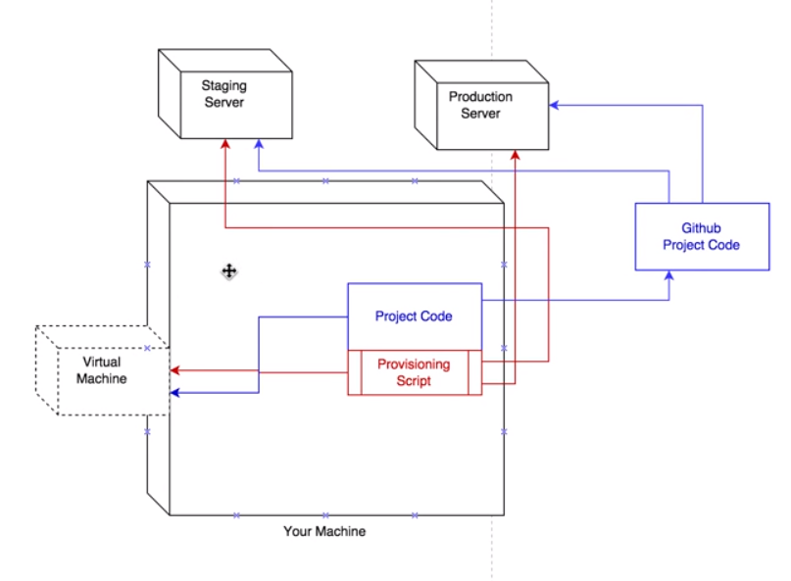
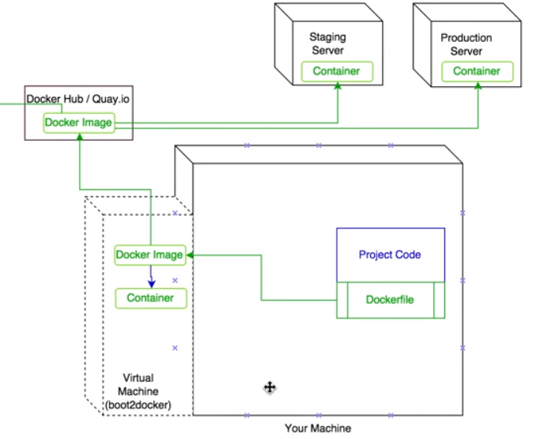
Using Virtual Box
Using Docker

Slide 7
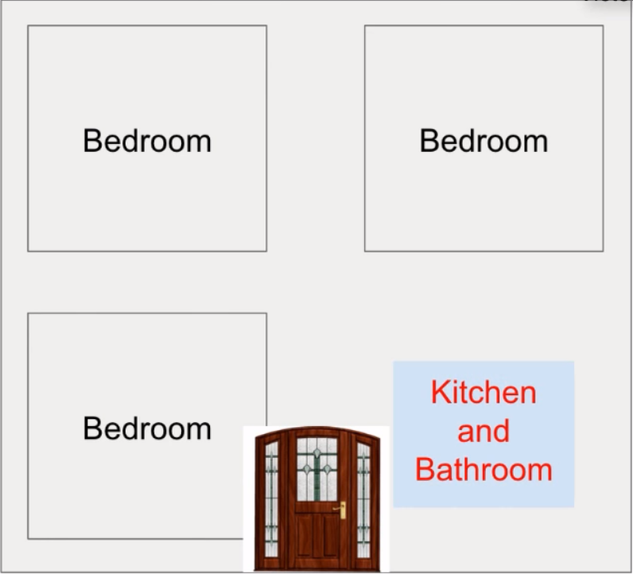
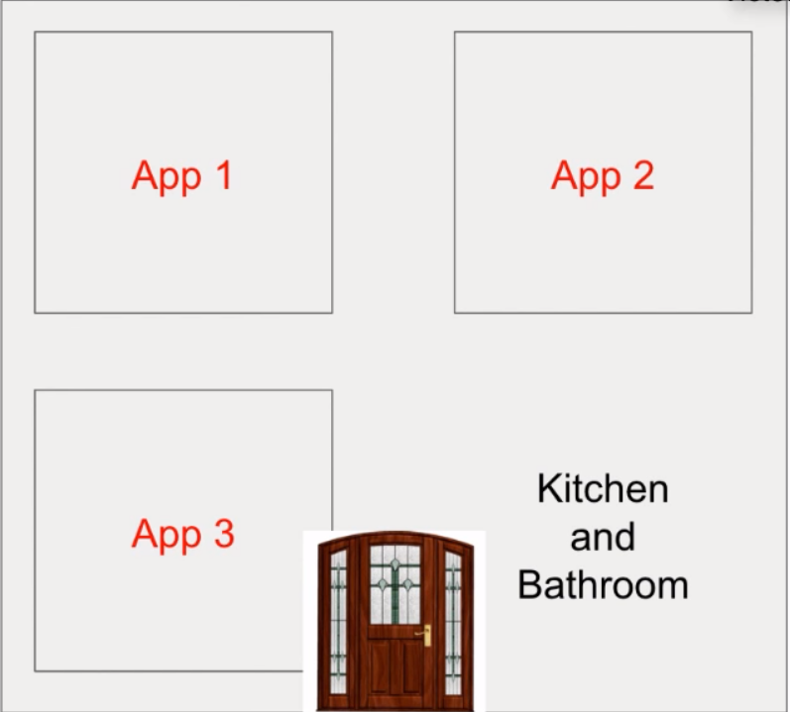
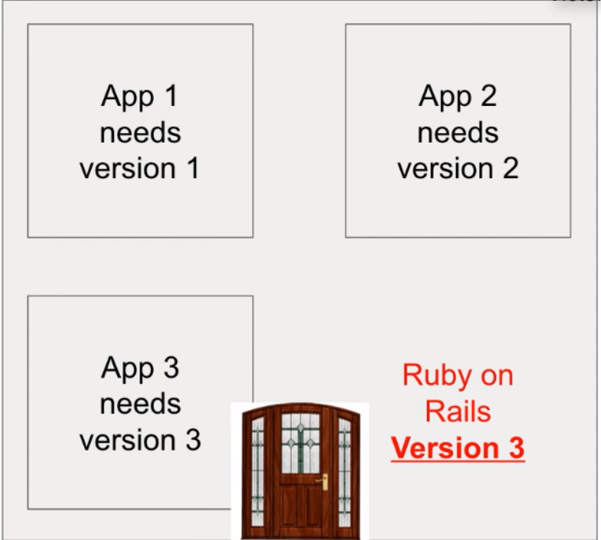
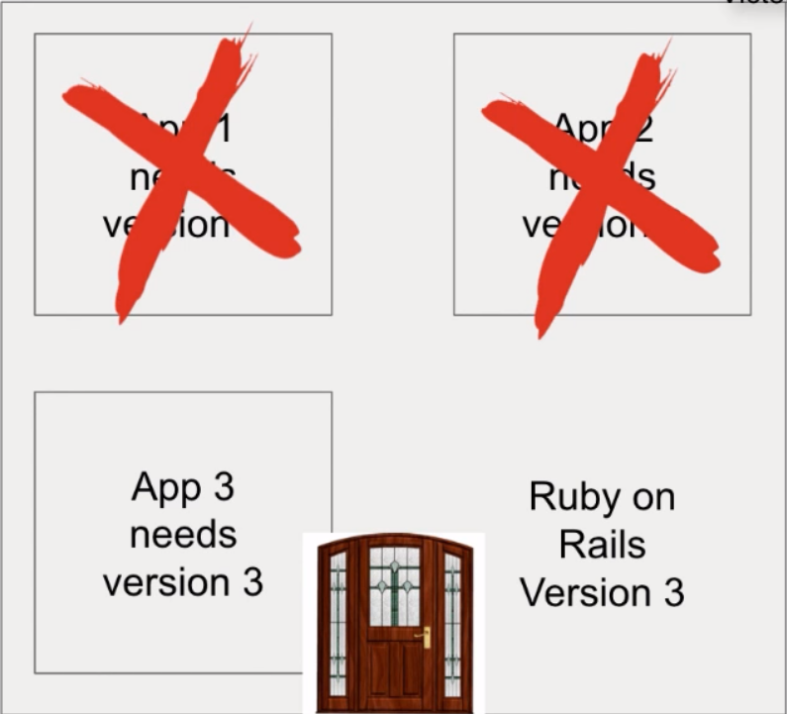

Slide 8
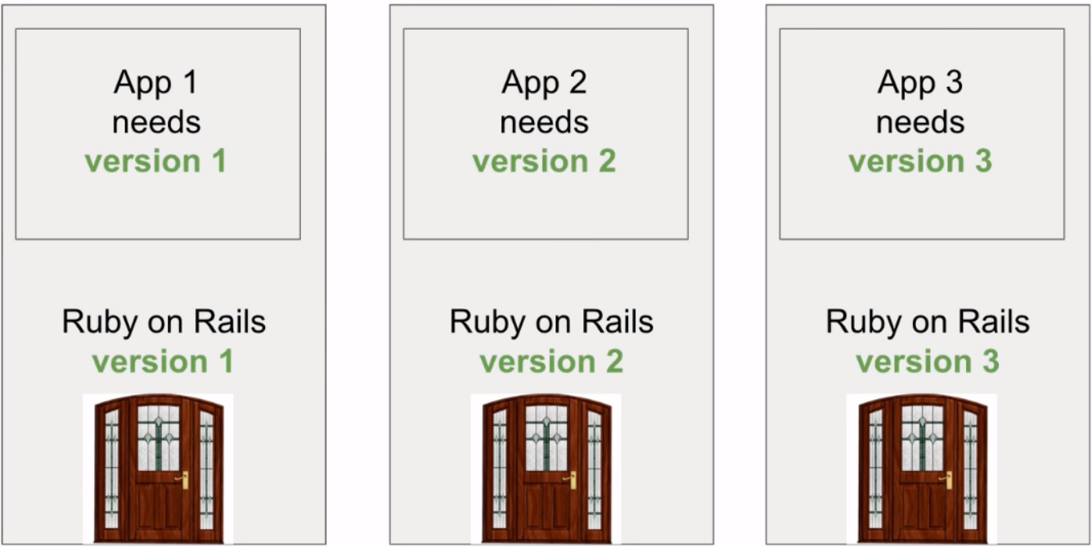
Solution 1: Buy and use three computers

Slide 9
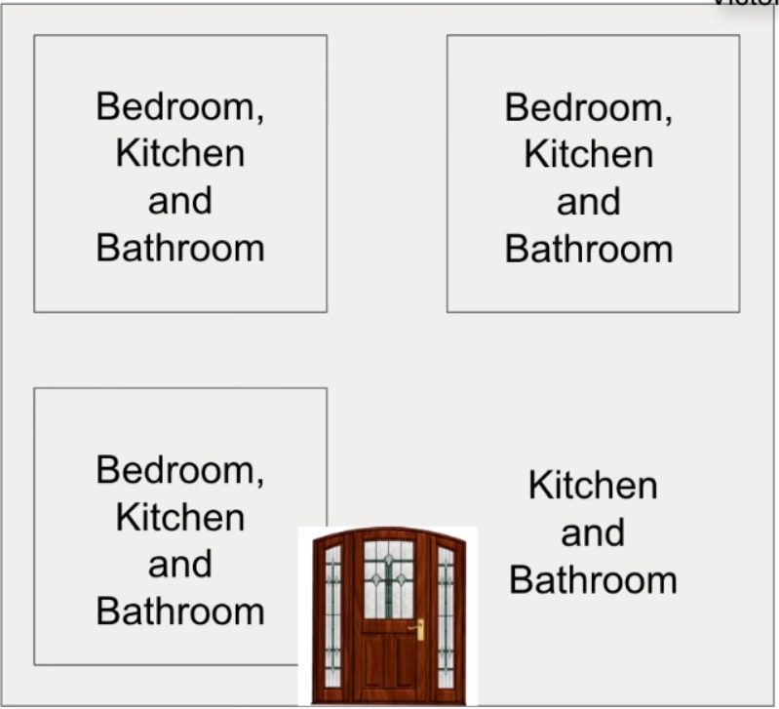
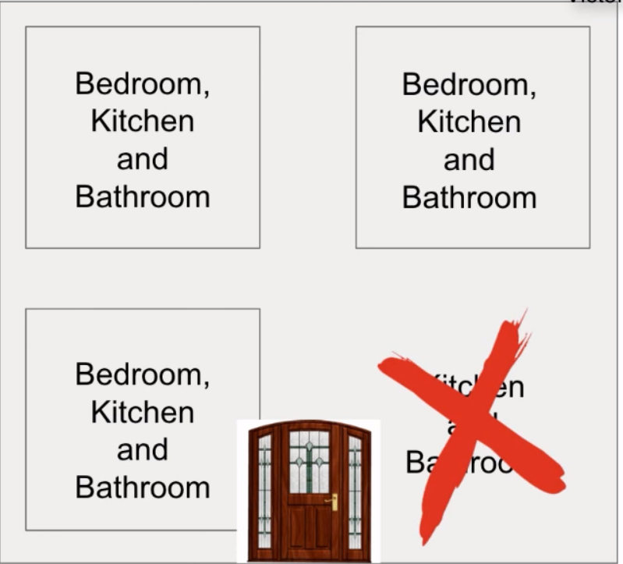
Solution 2: Use Docker

Slide 10
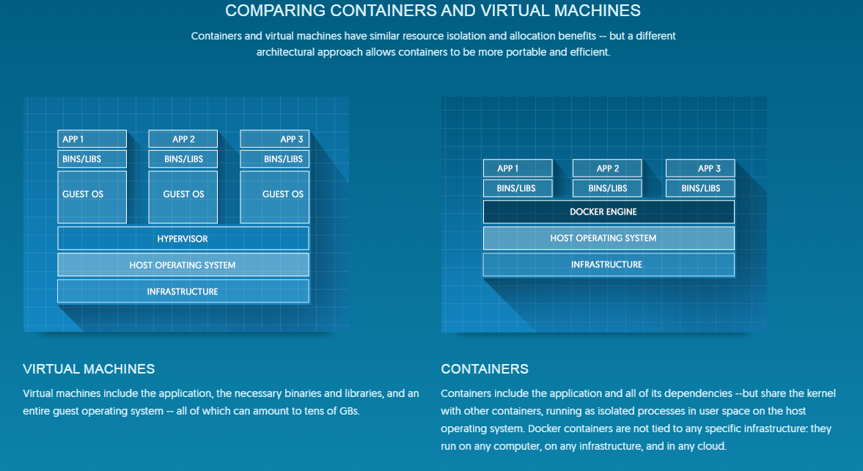

Slide 11
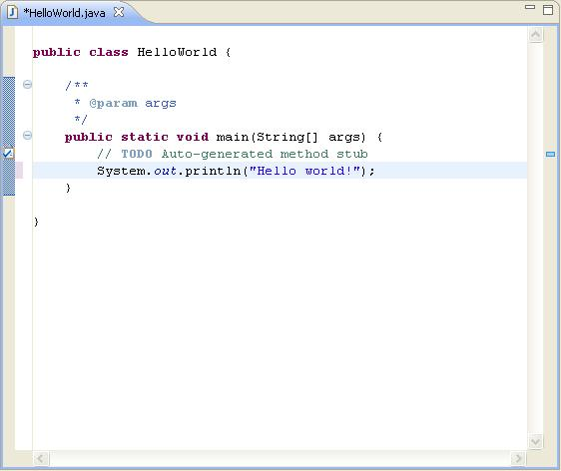
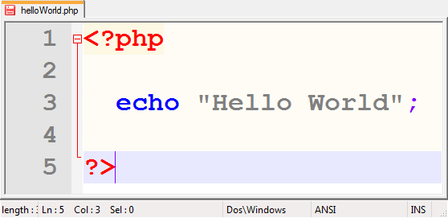
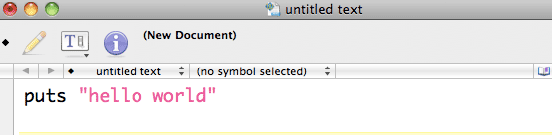
You can use any code in your containers!

Slide 12
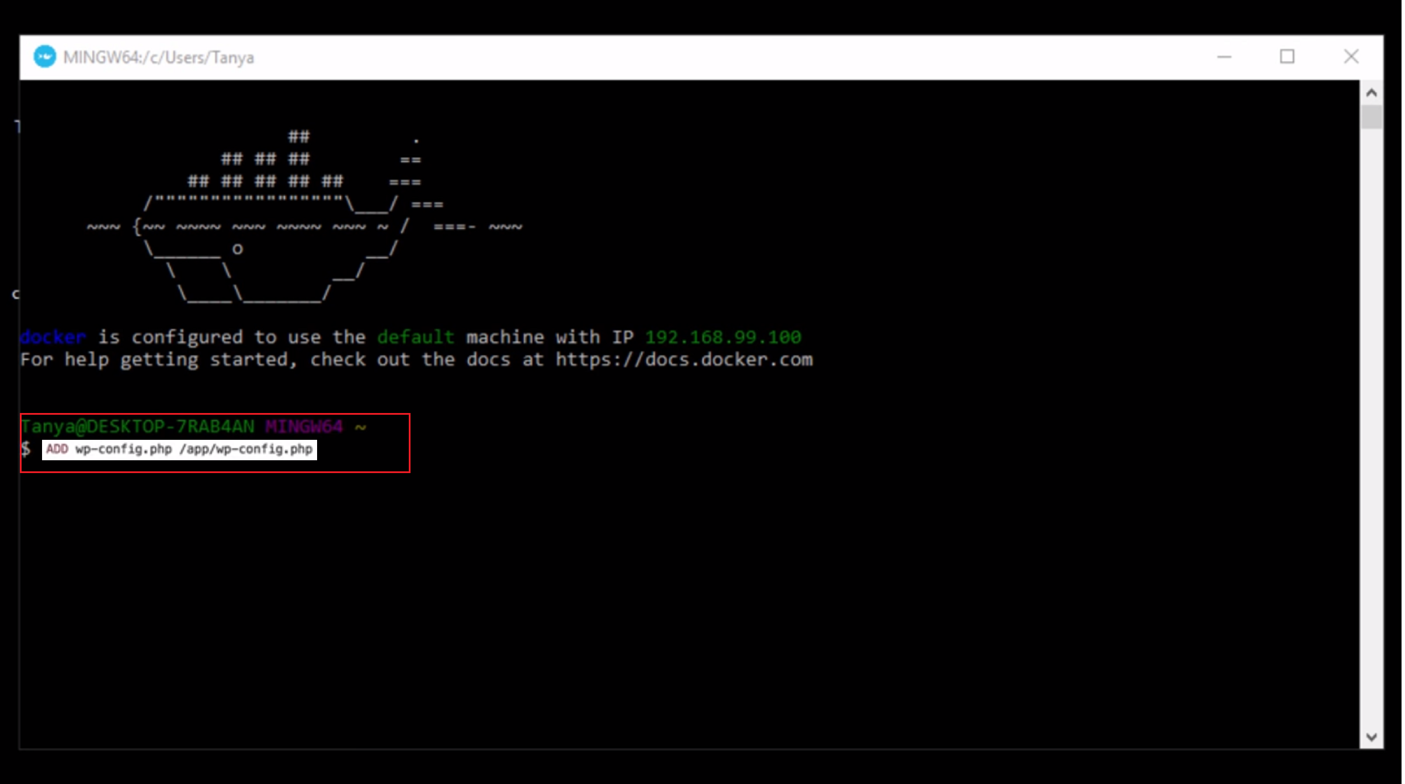
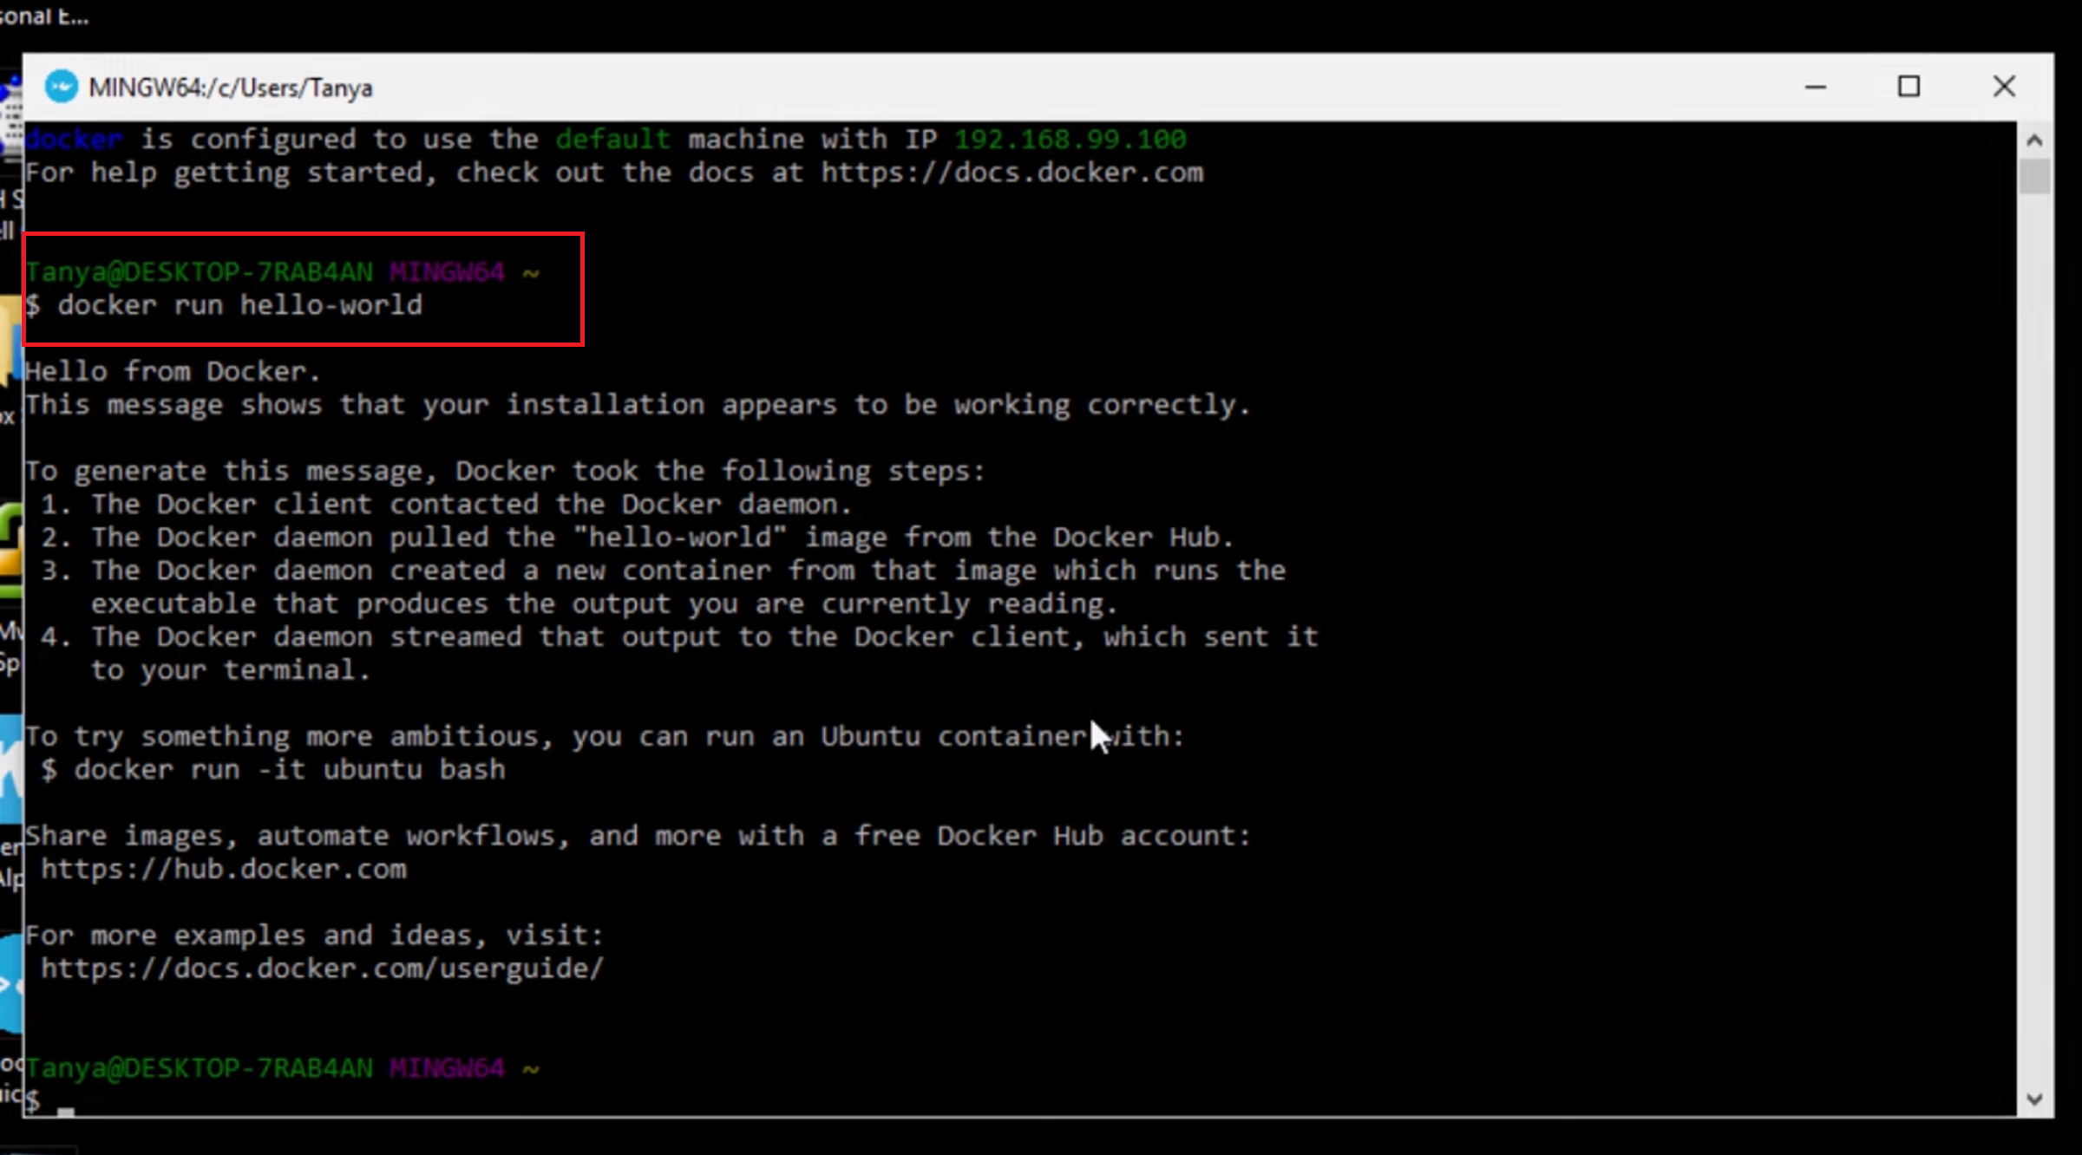
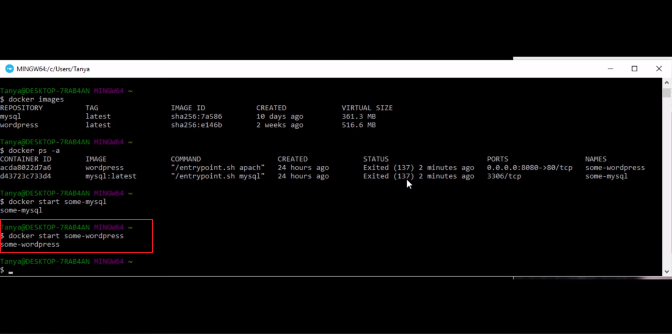
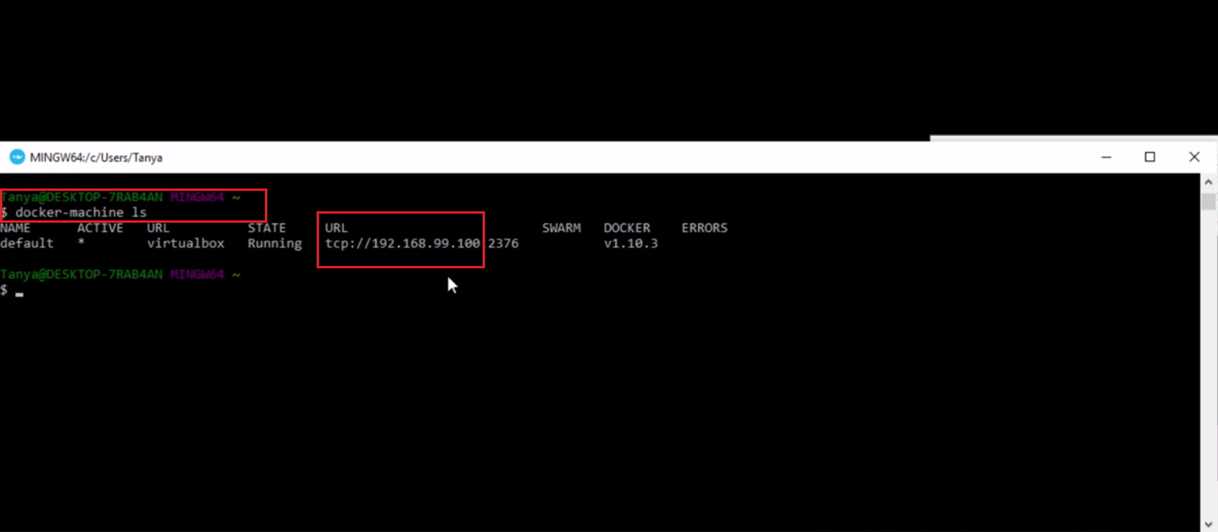
1
2
3
4

Slide 13
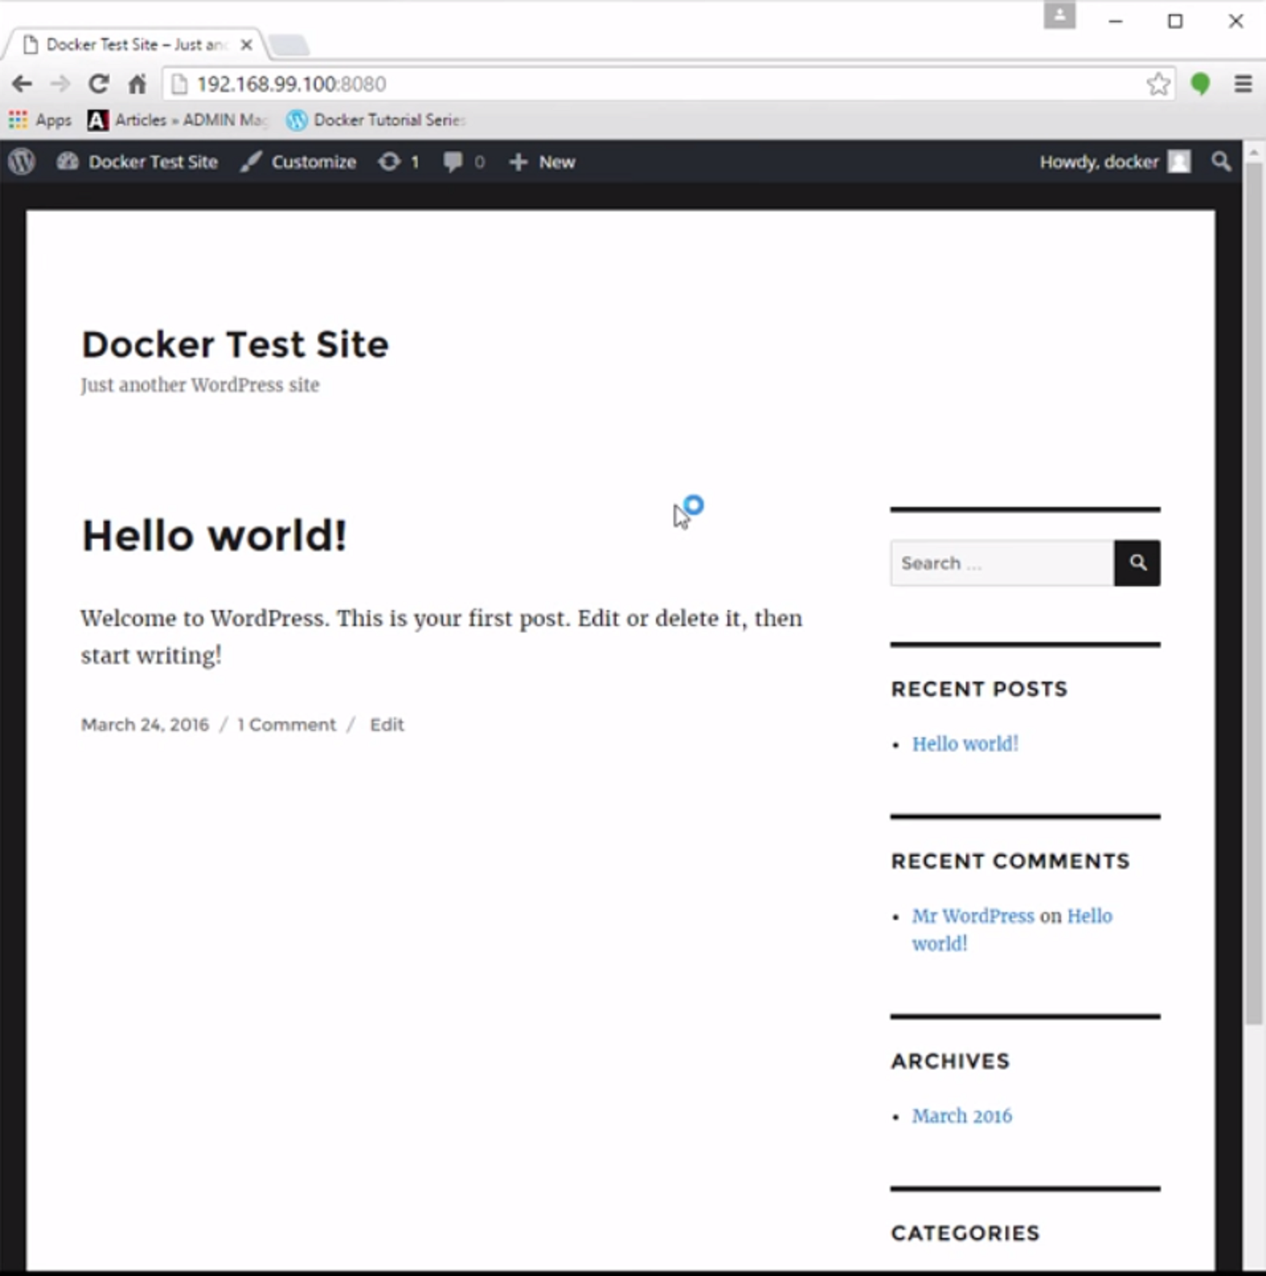
Result of running a successful Docker image

Slide 14
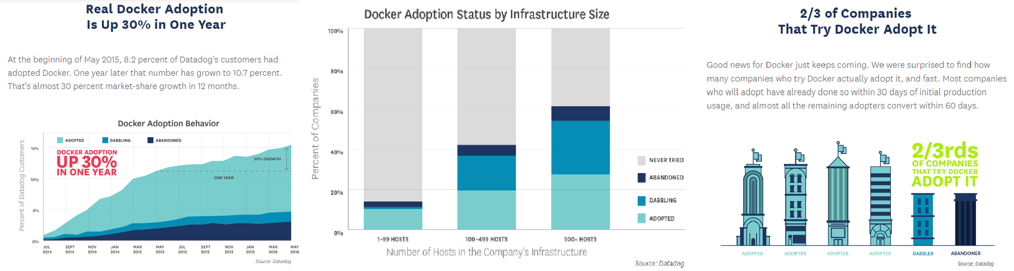
Is Docker being Adopted by Businesses?

Slide 15
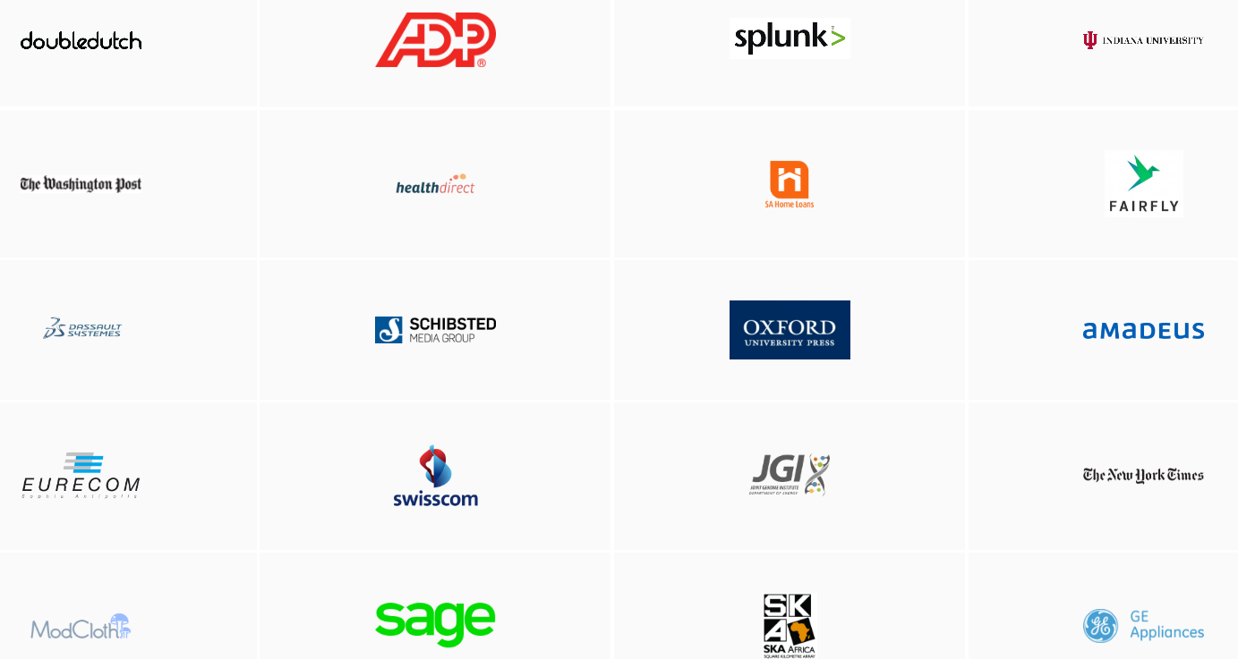
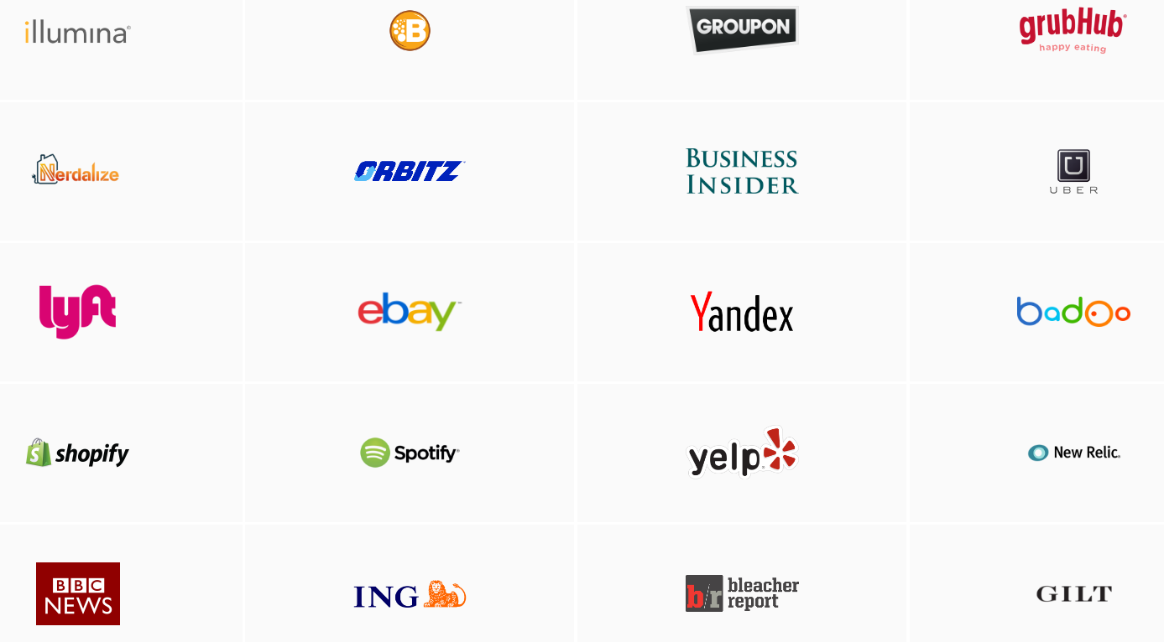
Who uses Docker?

Slide 16
The Washington Post’s Experience with Docker
https://www.youtube.com/watch?v=_PDoxTThGnY

Slide 17
Resources
Slide 2 - https://www.youtube.com/watch?v=RDVlAyec8fI
Slide 4 - http://www.forbes.com/sites/alexkonrad/2015/07/01/meet-docker-founder-solomon-hykes/#2629ef9e79fe https://www.docker.com/company
Slide 5 - http://blog.canadianwebhosting.com/everyday-linux-commands/linux-logo/ http://programe.njeklik.com/videos/virtualbox/ https://www.docker.com/
Slide 6 - https://www.youtube.com/watch?v=RDVlAyec8fI
Slides 7-9 - https://www.youtube.com/watch?v=t9YuqwGYUUg
Slide 10 - https://www.docker.com/what-docker#/VM
Slide 11 – http://www.java-made-easy.com/java-hello-world.html http://www.onlinetechtutorials.com/2011/11/hello-world-program-in-php.html http://techs.studyhorror.com/ruby-hello-world-eclipse-i-101
Slide 12-13 - https://www.youtube.com/watch?v=RDVlAyec8fI
Slide 15 - https://www.docker.com/customers

